Slide 1
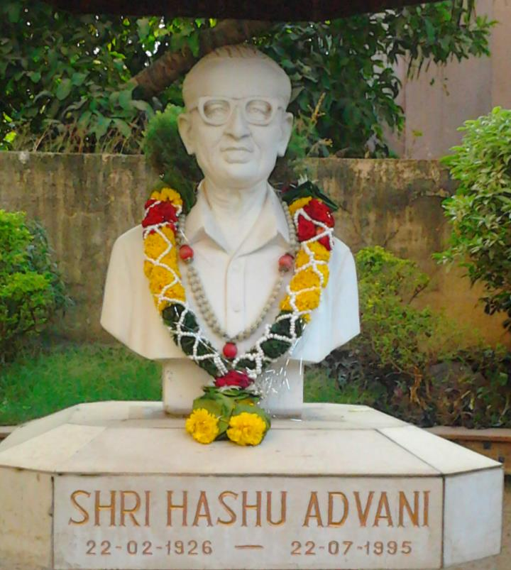
CHEMBUR COLONY YUVAK MANDAL’S
HASHU ADVANI COLLEGE OF SPECIAL EDUCATION

Slide 2
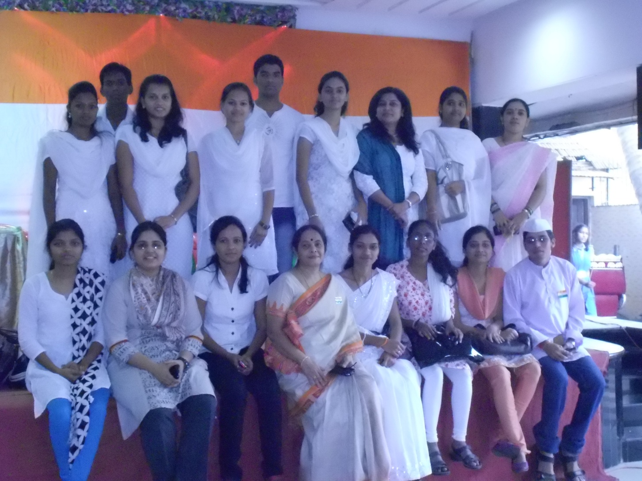
HACSE: We create attitudes….

Slide 3
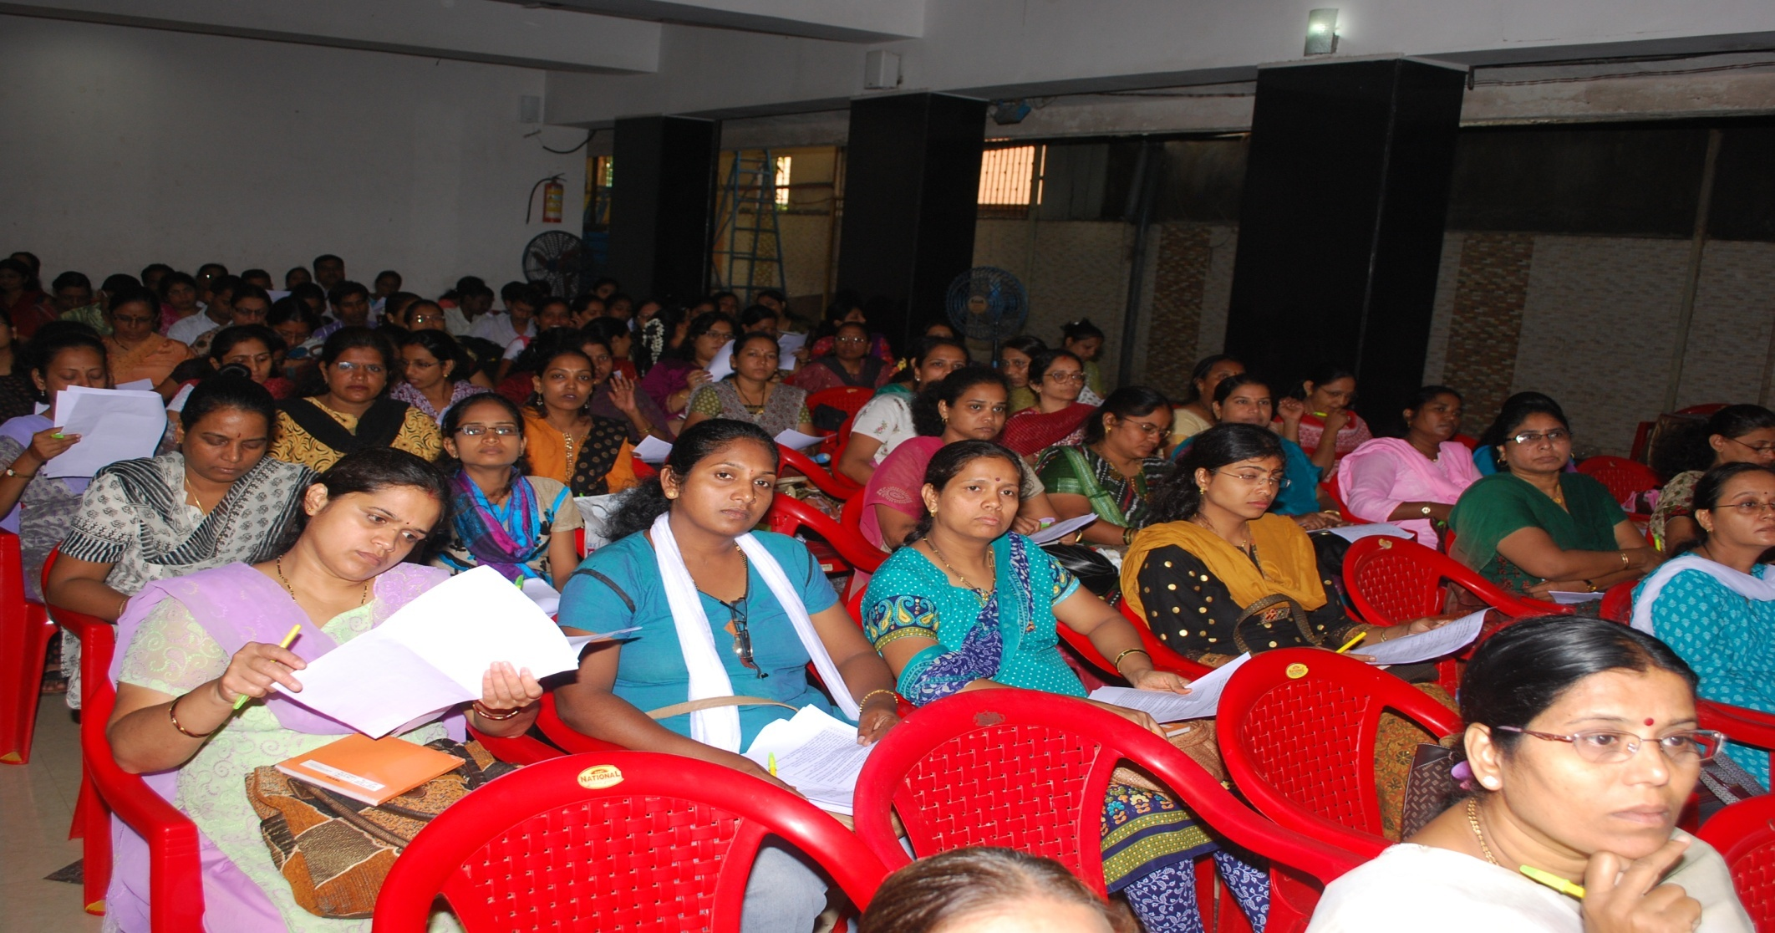
HACSE: we create opportunities…

Slide 4
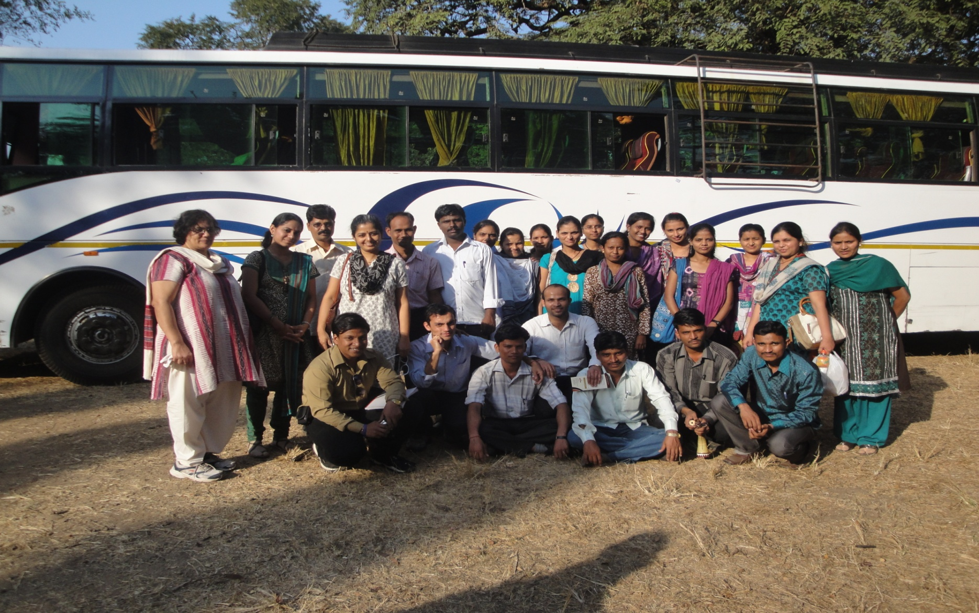
HACSE: we create teams…

Slide 5
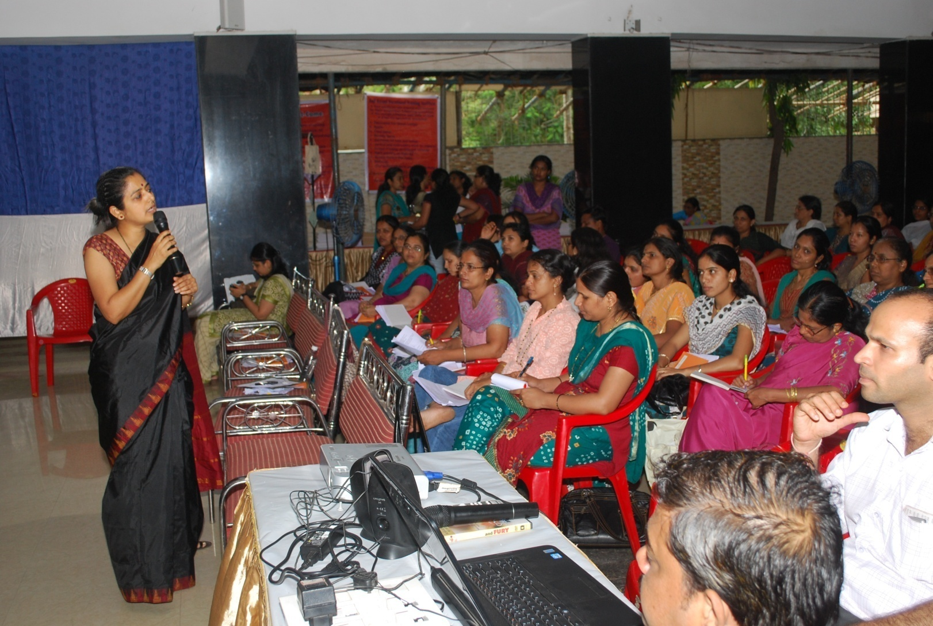
HACSE: We create answers….

Slide 6
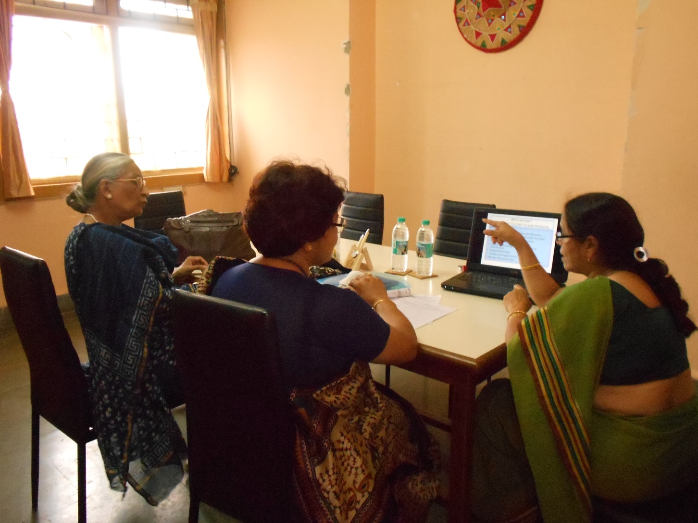
HACSE: we create collaborations…

Slide 7
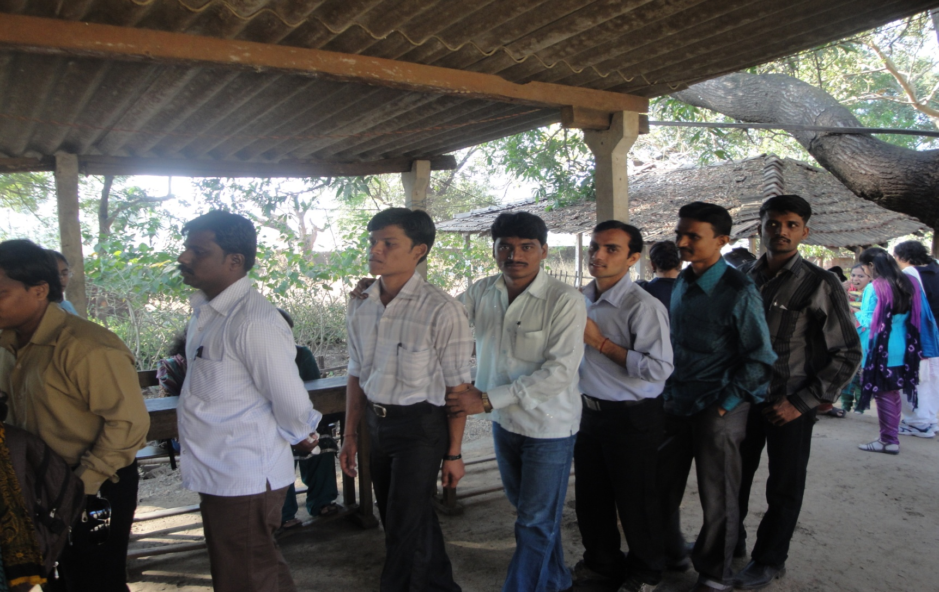
HACSE: we create citizens….

Slide 8
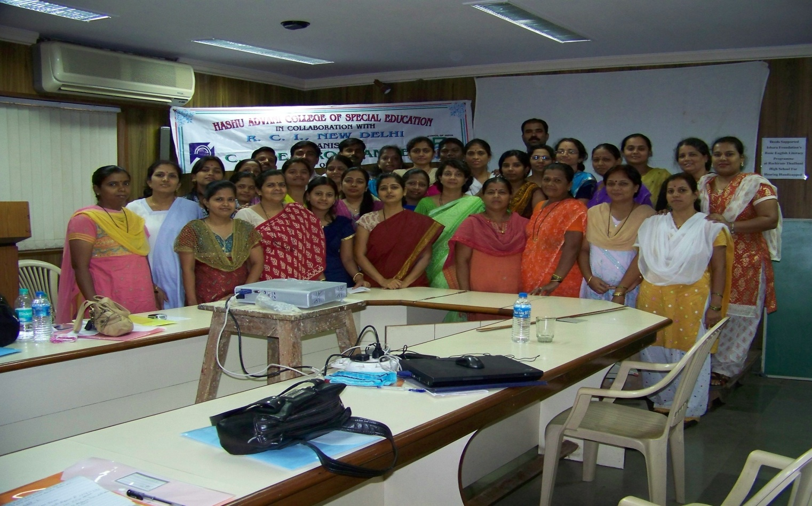
HACSE: www.hacse.org.in
Yes, we also create teachers…..

Slide 9


