Slide 1
www.hacse.org.in
Have you heard about LEARNING DISABILITY?
YES, quite a common thing!
Have you heard of B Ed Learning Disability?
Hmmmm….. Never!

Slide 2
www.hacse.org.in Know more about learning disability…… Do you know LD is…….

Slide 3
Invisible
disability
High incidence
disability
5 hour
disability

Slide 4
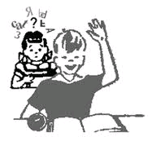
Focusing the invisible students
Students with
LEARNING DISABILITY

Slide 5
www.hacse.org.in
INCIDENCE OF LEARNING DISABILITY
Global estimate: 10 -12% of school going children.
This means in India For every class of 60 to 70 students minimum 6-7 have learning disability

Slide 6
And how many teacher training
B Ed programs do we have in India?
ONLY 7!!!!!
Do you see a gap?

Slide 7
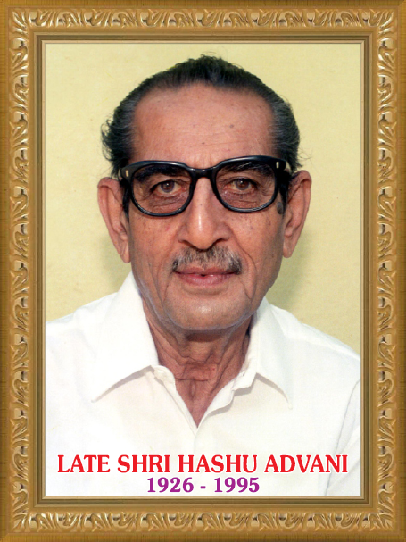
Inspired by our eternal source of strength HASHU ADVANI COLLEGE OF SPECIAL EDUCATION
Ambitious march towards expansion of services

Slide 8
NOW AT HACSE
B Ed (Special Education – LEARNING DISABILITY)
@
HASHU ADVANI COLLEGE OF SPECIAL EDUCATION
Recognized by Rehabilitation Council of India
Affiliated to Mumbai University

Slide 9
Come, join us in the venture……
Venture to ensure educational rights of children with
LEARNING DISABILITIES

